Slide 1
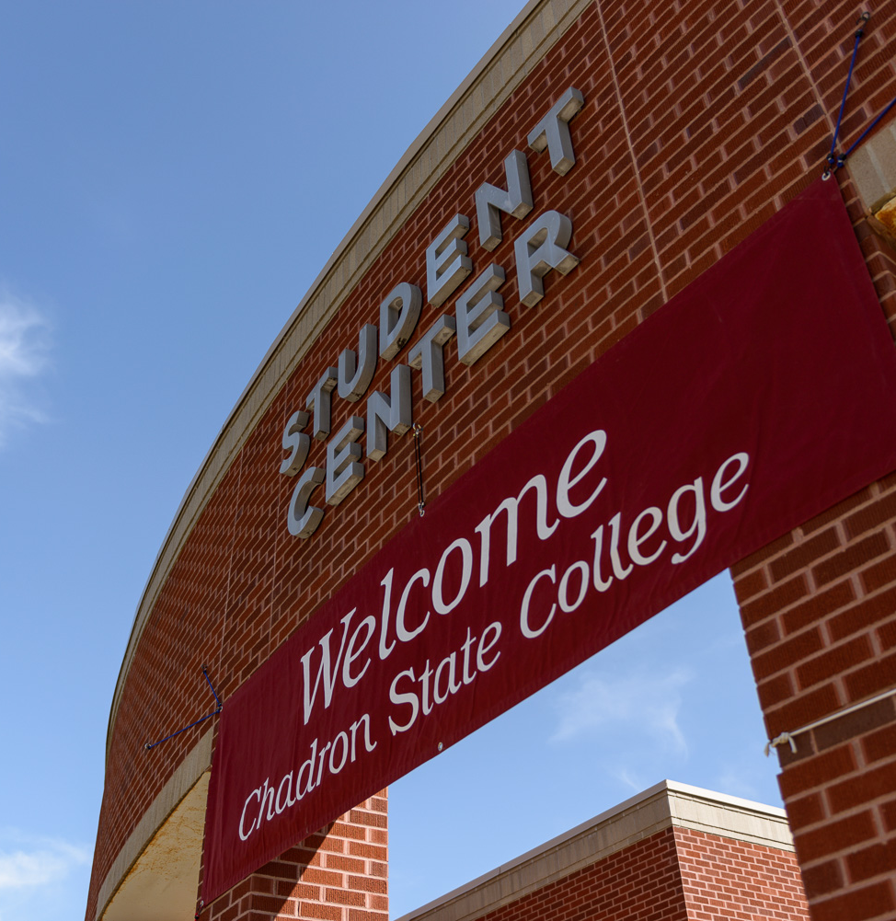

Welcome to
Accredited
8-Week Format
Affordable
Learning Oriented

Slide 2

Chadron State College
Quick Facts
Student-Faculty Ratio: 17-1
Average Class Size: 14
Faculty Excellence: 86% of our full-time faculty hold the highest degree in their fields

Slide 3
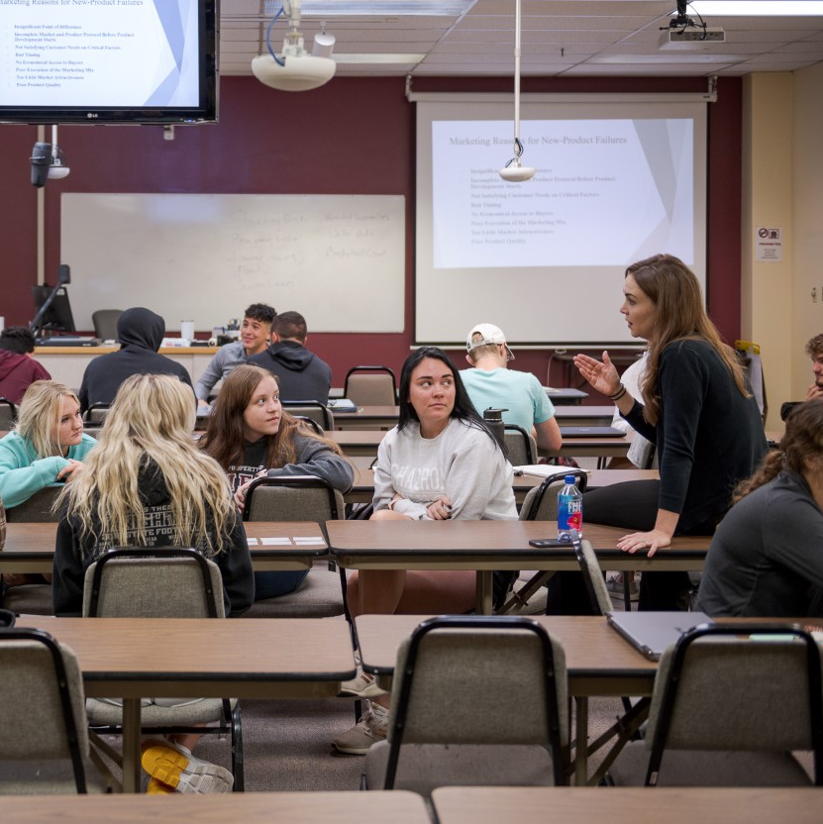
Comprehensive Major In Business Administration with Options In:
Accounting/CPA
Agribusiness
Business Information Systems
Finance
Management
Marketing
General Business with Outside Minor
BS in Education with Field Endorsement in Business, Marketing, Information Systems (6-12)
Bachelor of Arts = 120 total credits
  Essential Studies – 39 Credits
  Major – 36 Credits
  Option/Minor – 21 Credits
  Electives – 24 credits
    An opportunity to explore a variety of courses within a particular area of interest or add a second option or minor

Slide 4

Hybrid and Online Format
Hybrid Courses: Face-to-Face
and Online Components.
Online: Online offers convenience and flexibility.
Business classes offered in 8-week format
Less classes at a time
Curriculum built to be completed in four years
Flexible
Support services on campus-tutoring & writing center

Slide 5

Business Careers
Accounting
Financial Accountant
Government Accountant
Tax Accountant
Business Information Systems
I.T. Manager
Electronic Business or
E-Commerce Manager
Project Manager
Finance
Bank Officer
Financial Analyst
Stockbroker
Management
Employee Supervision
Mid-Level Management
Operations Management
Employee Training and
Development
Agribusiness
Banking and Financial Institutions
Agribusiness Management
Sales and Marketing
Marketing
Sales and Marketing
Marketing Analyst
Digital Marketing
“We are in the business of growing people—people who are stronger, healthier, more autonomous, more self-reliant, and more competent.” – Robert Greenleaf

Slide 6


Student Opportunities
FBLA Collegiate
An organization for developing leadership, communication, and team skills
A way to meet and network with others at the local, state, or national levels
Interested in joining? Contact our faculty adviser Dr. Gary Dusek at gdusek@csc.edu or get connected with us via Facebook for more information
Delta Mu Delta – Kappa Kappa Chapter
A business honor society that recognizes and encourages academic excellence of students through life-time membership
An honor indicative of earnest, intelligent purpose and rewarding achievement
This should be the goal of every person pursuing a degree in business administration.
The standards of Delta Mu Delta are high

Slide 7
Rural Business Leadership Initiative (RBLI)
RBLI – Preparing business students for careers in rural areas
Concentrates on:
  Leadership and career development
  Networking
  Internship opportunities
Full, four-year tuition scholarship
  15 credit hours a semester
No minimum ACT scores. Must maintain a 3.0 GPA to remain in the program
Easy online application
  Apply online at: csc.edu/rbli/
  Application deadline: February 28th.

Slide 8
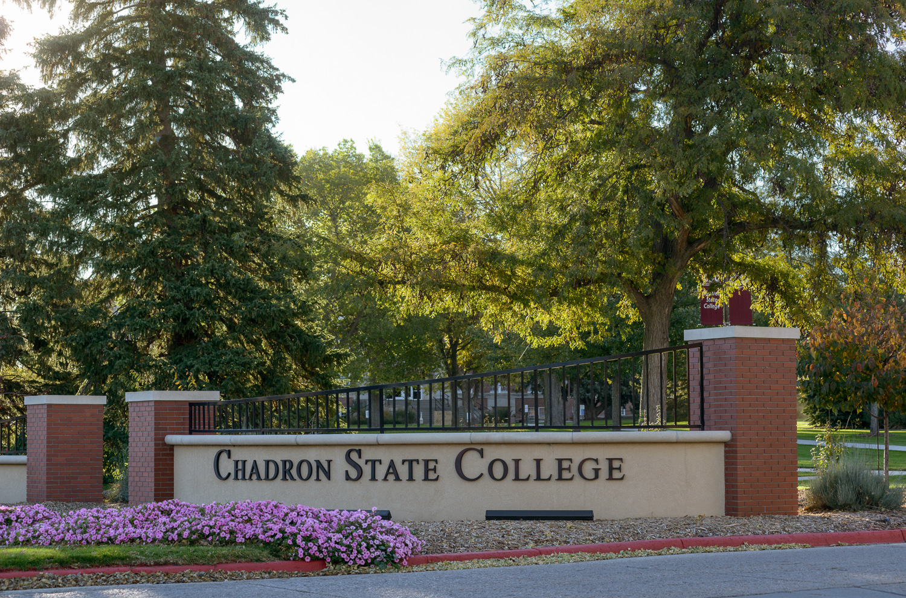
Chadron State College
Master of Business Administration
The MBA is designed for supervisory and mid-level managers
Adds to body of knowledge in Business Management, Marketing, Finance, Accounting, Economics, and Informational
Management Systems
  Can be completed in 1.5-7 years
  Offered Online in 8-week format

Slide 9

Thank you for Visiting!
For More Information Visit:
https://www.csc.edu/business/index.csc

